Slide 1

Success for Life
Your school name here

Slide 2


Slide 3
What is Bullying?
Bullying is when someone intentionally hurts you, whether it’s physically or emotionally.

Slide 4
Why Do People Bully?
It makes them feel better about themselves
They need to be in control
To get attention

Slide 5
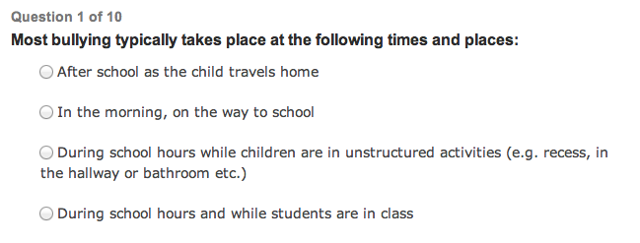
Bullying Quiz: How Informed Are You?

Slide 6
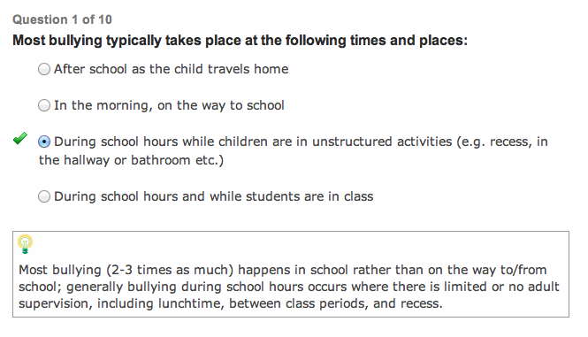

Slide 7

Be Confident
How you present yourself can stop bullying before it starts.
  Hold Your Head High
  Walk with Confidence
  Make Eye Contact

Slide 8
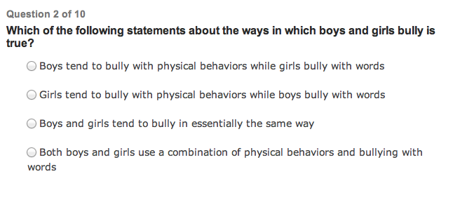

Slide 9
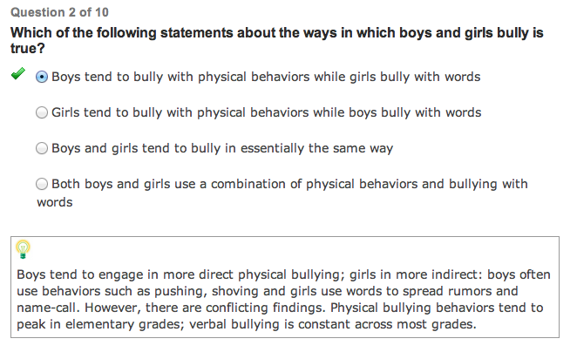

Slide 10
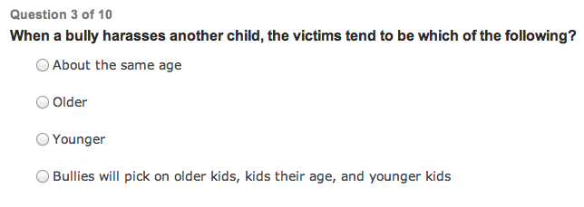

Slide 11
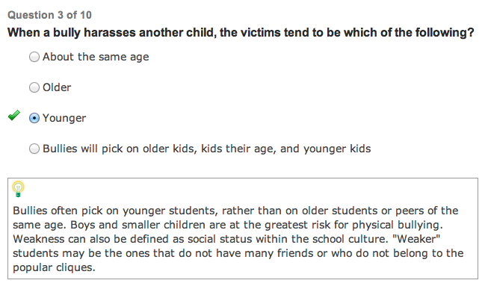

Slide 12
Verbal Skills
Change the subject
Use Humor
Make the Bully your Friend

Slide 13
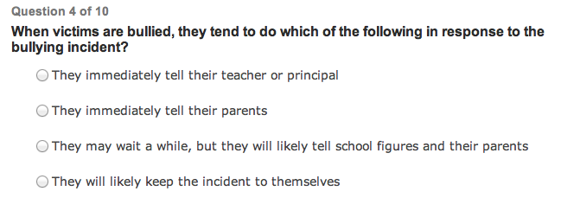

Slide 14
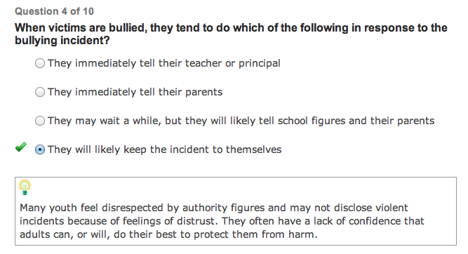

Slide 15
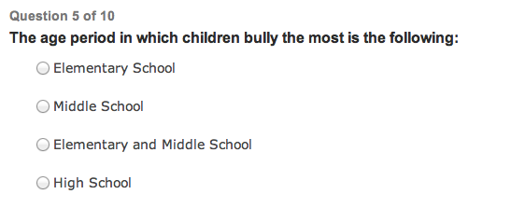

Slide 16
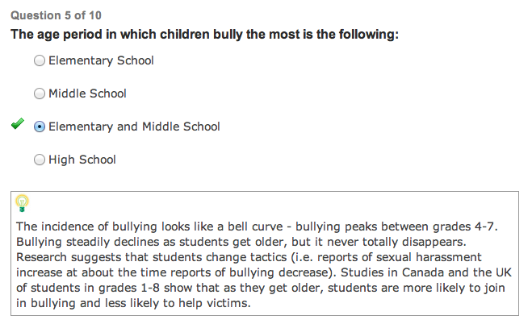

Slide 17
Whoa! I Don’t Want to Fight
Simple stand to the side, put your hand up in an open position, keep your chin down.
  Use your verbal skills to distract the bully.

Slide 18
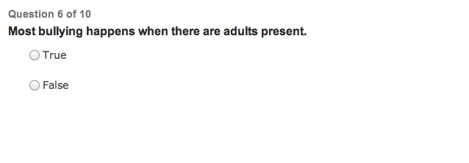

Slide 19
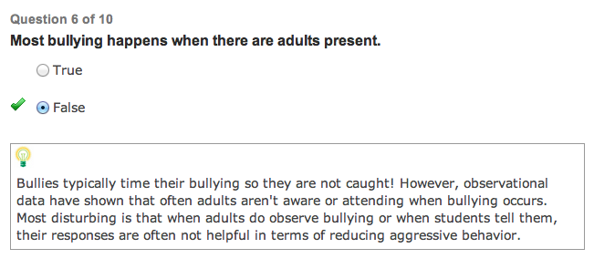

Slide 20
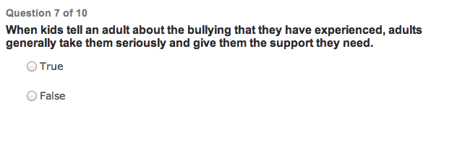

Slide 21
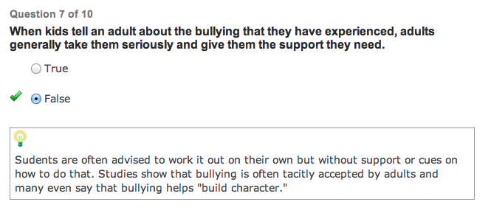

Slide 22
Let’s Take Action Against Bullying
Basic Blocks
  High block
  Low Block
  Inside Block
  Outside Block

Slide 23
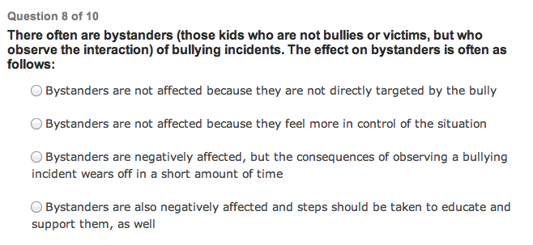

Slide 24
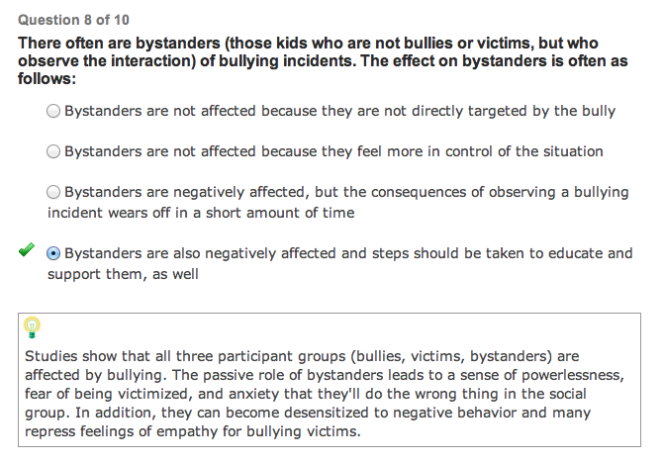

Slide 25
Let’s Take a Stance
Guarding/fighting stance
Back fist
Reverse Punch
Front Kick

Slide 26
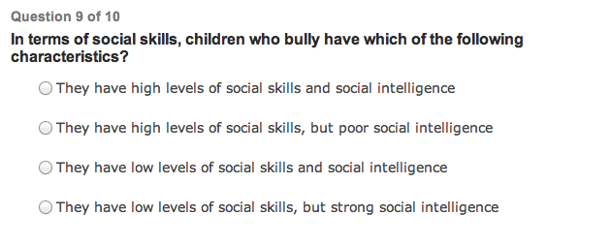

Slide 27
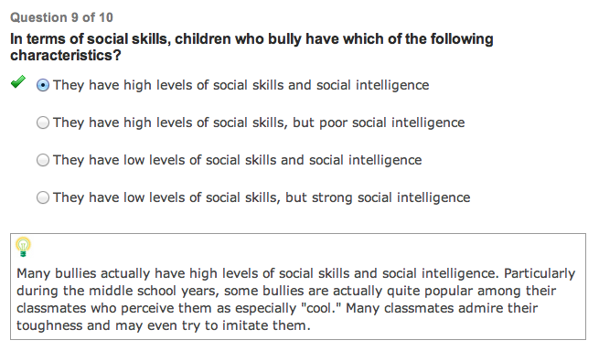

Slide 28
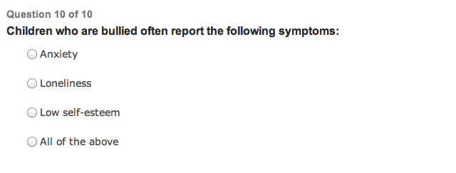

Slide 29
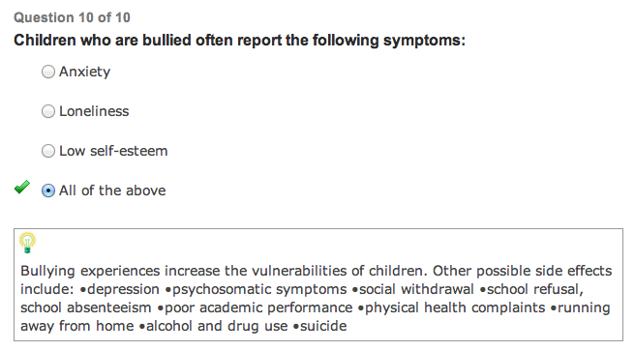

Slide 30
Stun and Run
When all else fails…..
  STUN and RUN!

Slide 31
Report Bullying
When you feel the bullying is going to become physically violent.
When bullying involves racial, religious, or gender attacks
When bullying is directed toward someone with a disability
When a bully takes something that belongs to you
When you haven’t been able to stop the bullying using the steps you have learned today!

Slide 32
Board Breaking!

Slide 33

Thank you for coming!
American Freestyle Karate - Staunton

